Slide 1
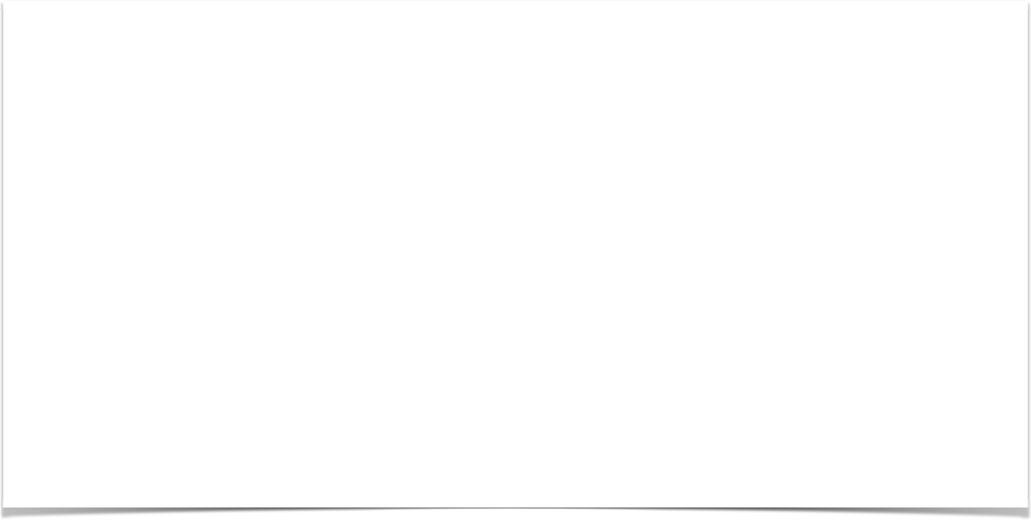

SPRING MVC OVERVIEW
Date

Slide 2
What is Spring MVC?
•
Framework for building web applications in Java
•
Based on Model-View-Controller design pattern
•
Leverages features of the Core Spring Framework (IoC, DI)

Slide 3




Model-View-Controller (MVC)
Front Controller
Model
Web Browser
Controller
Model
View Template

Slide 4
Spring MVC Benefits
•
The Spring way of building web app UIs in Java
•
Leverage a set of reusable UI components
•
Help manage application state for web requests
•
Process form data: validation, conversion etc
•
Flexible configuration for the view layer

Slide 5
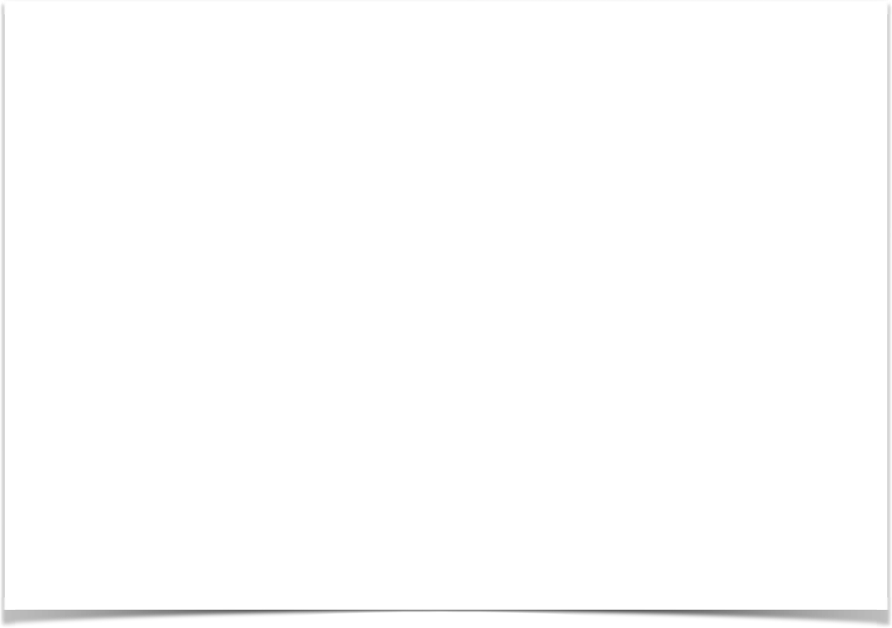
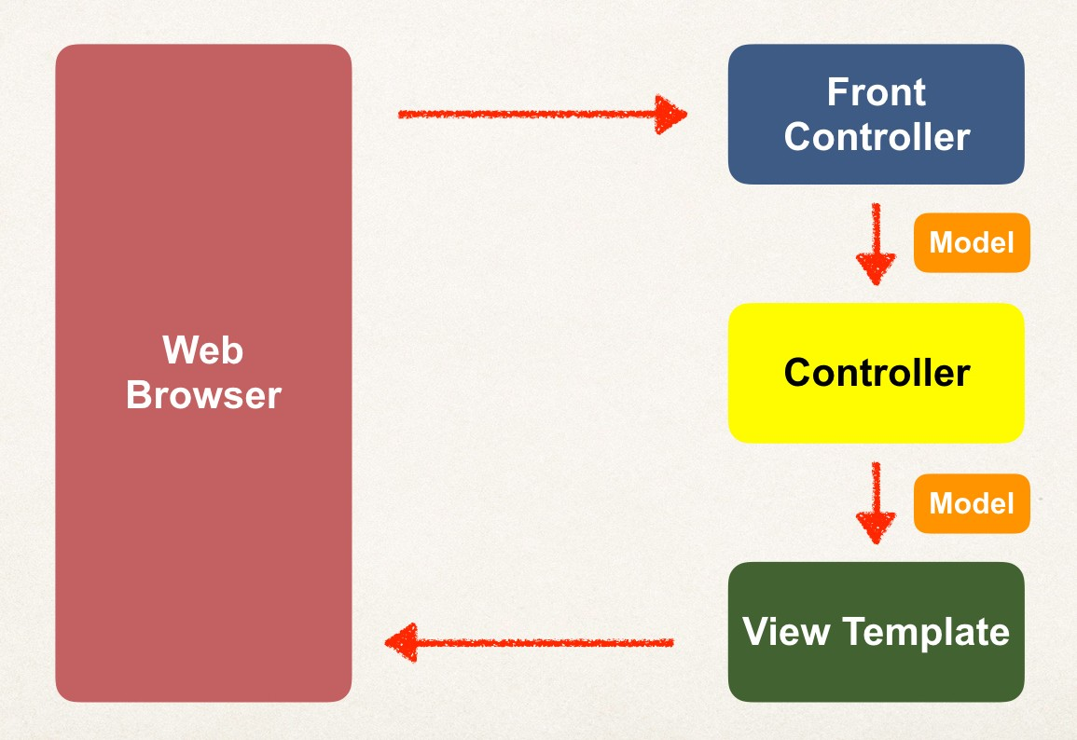
Spring MVC Front Controller
•
Front controller known as DispatcherServlet
Part of the Spring Framework
Already developed by Spring Dev Team
•
You will create
Model objects (orange)
View templates (dark green)
Controller classes (yellow)

Slide 6
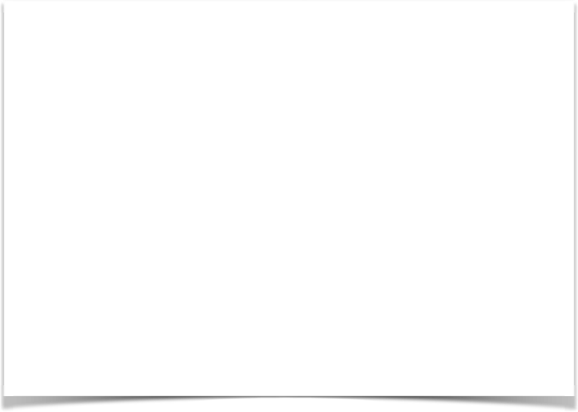
Controller
Code created by developer
•
Contains your business logic
Handle the request
Store/retrieve data (db, web service…)
Place data in model
•
Send to appropriate view template

Slide 7
Model
•
Model: contains your data
•
Store/retrieve data via backend systems
•
database, web service, etc…
•
Use a Spring bean if you like
•
Place your data in the model
•
Data can be any Java object/collection

Slide 8
View Template
Spring MVC is flexible
Supports many view templates
•
Most common is JSP + JSTL
•
Developer creates a page
Displays data
JSP: Java Server Pages
JSTL: JSP Standard Tag Library

Slide 9

Dev Environment Check Point
At this point in the video series you should have installed:
Apache Tomcat
Eclipse (Java EE version) Connected Eclipse to Tomcat
www.luv2code.com

Slide 10
SPRING MVC CONFIGURATION
Date

Slide 11
Spring MVC Configuration Process - Part 1
Add configurations to file: WEB-INF/web.xml
Configure Spring MVC Dispatcher Servlet
Set up URL mappings to Spring MVC Dispatcher Servlet
Step-By-Step

Slide 12
Spring MVC Configuration Process - Part 2
Add configurations to file: WEB-INF/spring-mvc-demo-servlet.xml
Add support for Spring component scanning
Add support for conversion, formatting and validation
Configure Spring MVC View Resolver
Step-By-Step

Slide 13
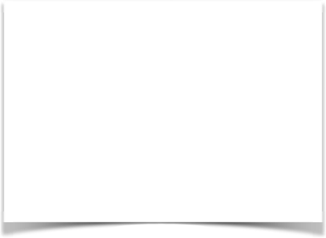
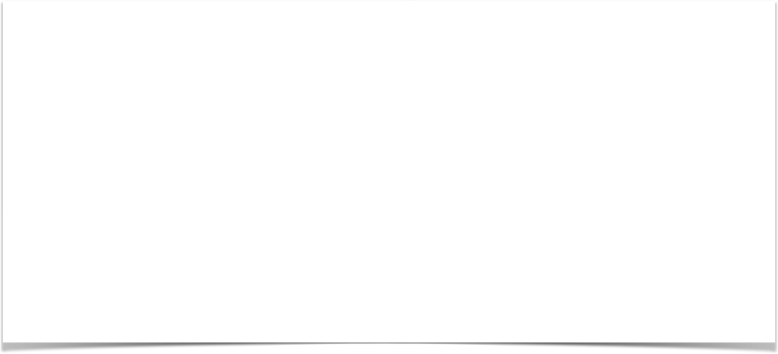
Step 1: Configure Spring DispatcherServlet
File: web.xml
<web-app>
<servlet>
<servlet-name>dispatcher</servlet-name>
<servlet-class>org.springframework.web.servlet.DispatcherServlet</servlet-class>
<init-param>
<param-name>contextConfigLocation</param-name>
<param-value>/WEB-INF/spring-mvc-demo-servlet.xml</param-value>
</init-param>
<load-on-startup>1</load-on-startup>
</servlet>
</web-app>

Slide 14
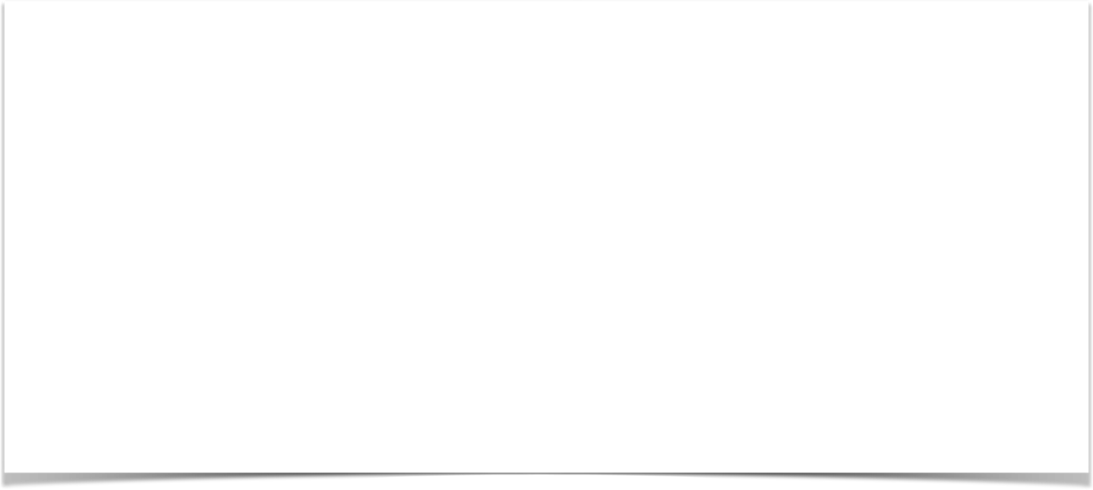
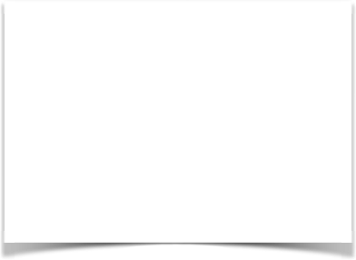
Step 2: Set up URL mappings to Spring MVC Dispatcher Servlet
File: web.xml
<web-app>
<servlet>
<servlet-name>dispatcher</servlet-name>
<servlet-class>org.springframework.web.servlet.DispatcherServlet</servlet-class>
...
</servlet>
<servlet-mapping>
<servlet-name>dispatcher</servlet-name>
<url-pattern>/</url-pattern>
</servlet-mapping>
</web-app>

Slide 15
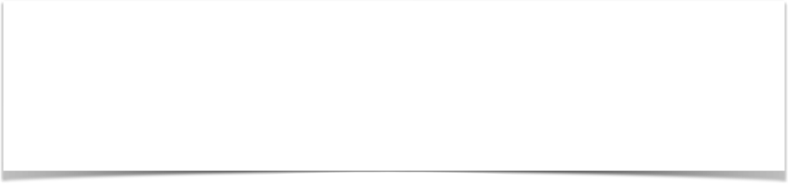
Step 3: Add support for Spring component scanning
File: spring-mvc-demo-servlet.xml
<beans>
<!-- Step 3: Add support for component scanning -->
<context:component-scan base-package="com.luv2code.springdemo" />
</beans>

Slide 16
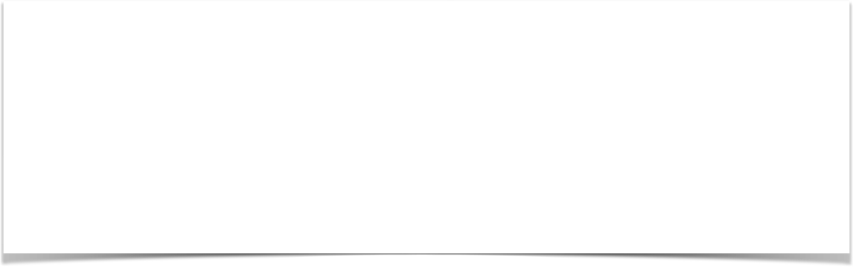
Step 4: Add support for conversion, formatting and validation
File: spring-mvc-demo-servlet.xml
<beans>
<!-- Step 3: Add support for component scanning -->
<context:component-scan base-package="com.luv2code.springdemo" />
<!-- Step 4: Add support for conversion, formatting and validation support -->
<mvc:annotation-driven/>
</beans>

Slide 17
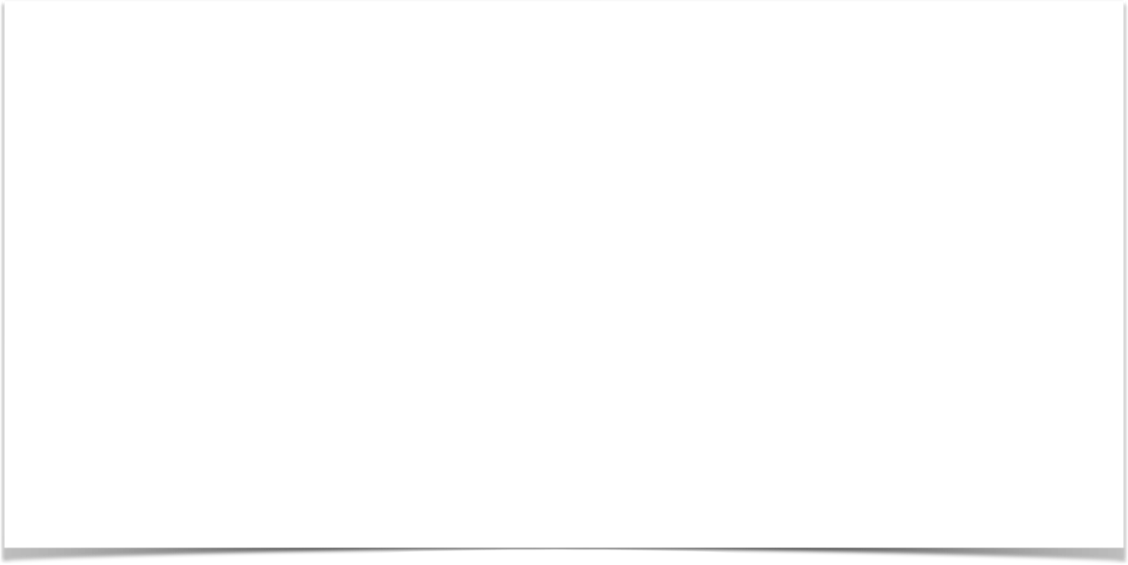
Step 5: Configure Spring MVC View Resolver
File: spring-mvc-demo-servlet.xml
<beans>
<!-- Step 3: Add support for component scanning -->
<context:component-scan base-package="com.luv2code.springdemo" />
<!-- Step 4: Add support for conversion, formatting and validation support -->
<mvc:annotation-driven/>
<!-- Step 5: Define Spring MVC view resolver -->
<bean
class="org.springframework.web.servlet.view.InternalResourceViewResolver">
<property name="prefix" value="/WEB-INF/view/" />
<property name="suffix" value=".jsp" />
</bean>
</beans>

Slide 18
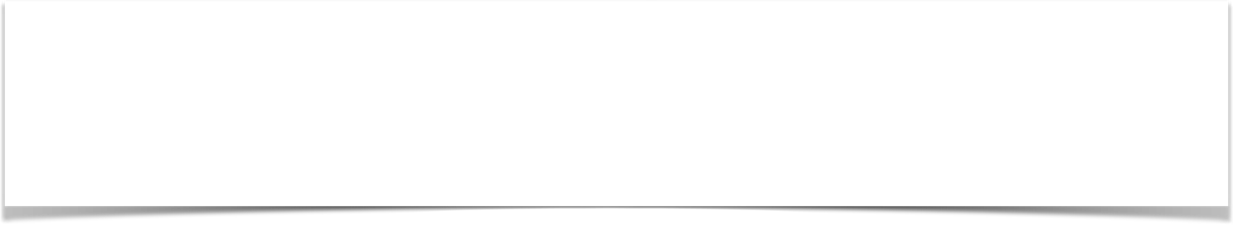
View Resolver Configs - Explained
When your app provides a “view” name, Spring MVC will
prepend the prefix
append the suffix
<bean
class="org.springframework.web.servlet.view.InternalResourceViewResolver">
<property name="prefix" value="/WEB-INF/view/" />
<property name="suffix" value=".jsp" />
</bean>

Slide 19

View Resolver Configs - Explained
<bean
class="org.springframework.web.servlet.view.InternalResourceViewResolver">
<property name="prefix" value="/WEB-INF/view/" />
<property name="suffix" value=".jsp" />
</bean>
/WEB-INF/view/
show-student-list
.jsp
View name

Slide 20
Developing
Spring Controllers and Views
Date

Slide 21
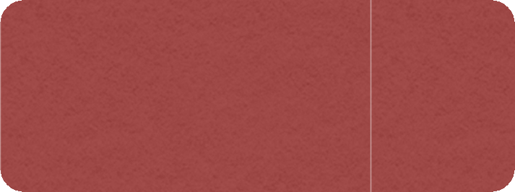


Our First Spring MVC Example
Request Path:
/
HomeController
main- menu.jsp

Slide 22
Development Process
Step-By-Step
Create Controller class
Define Controller method
Add Request Mapping to Controller method
Return View Name
Develop View Page

Slide 23
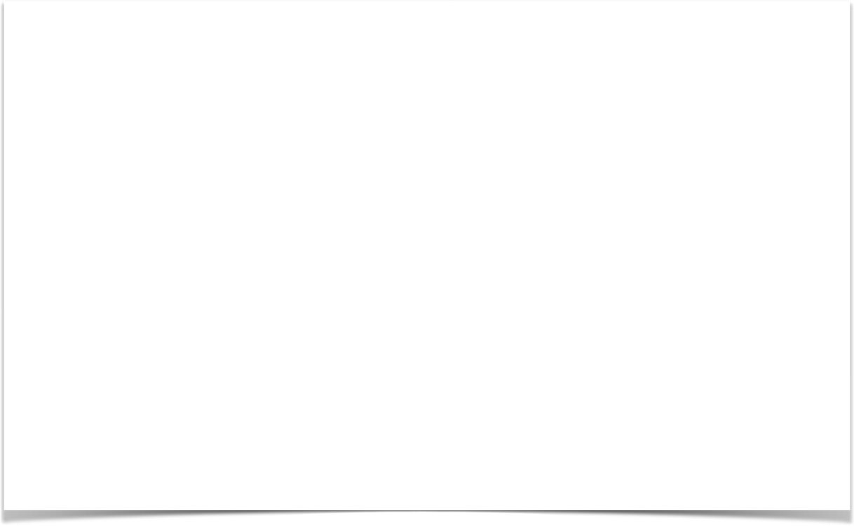
@Controller
public class HomeController {
@RequestMapping("/")
public String showMyPage() {
return "main-menu";
}
}
www.luv2code.com

Slide 24
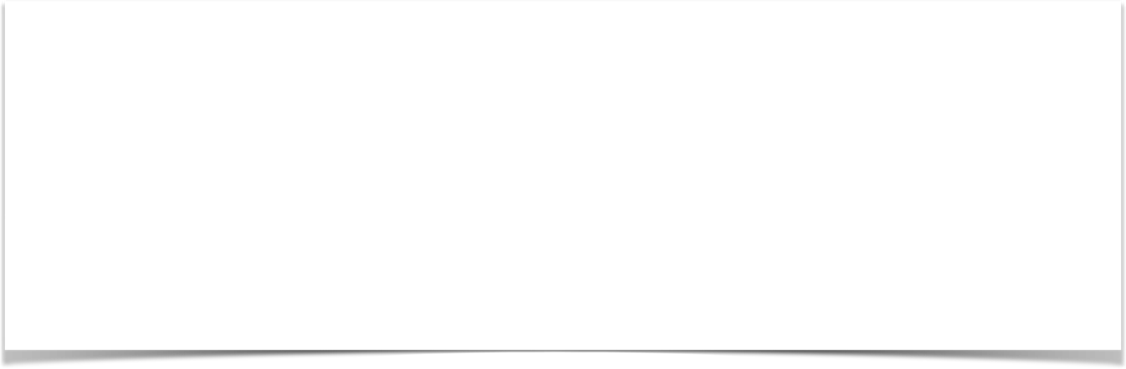
File: /WEB-INF/view/main-menu.jsp
<html><body>
<h2>Spring MVC Demo - Home Page</h2>
</body></html>
www.luv2code.com

Slide 25
Reading Form Data with Spring MVC
Date

Slide 26
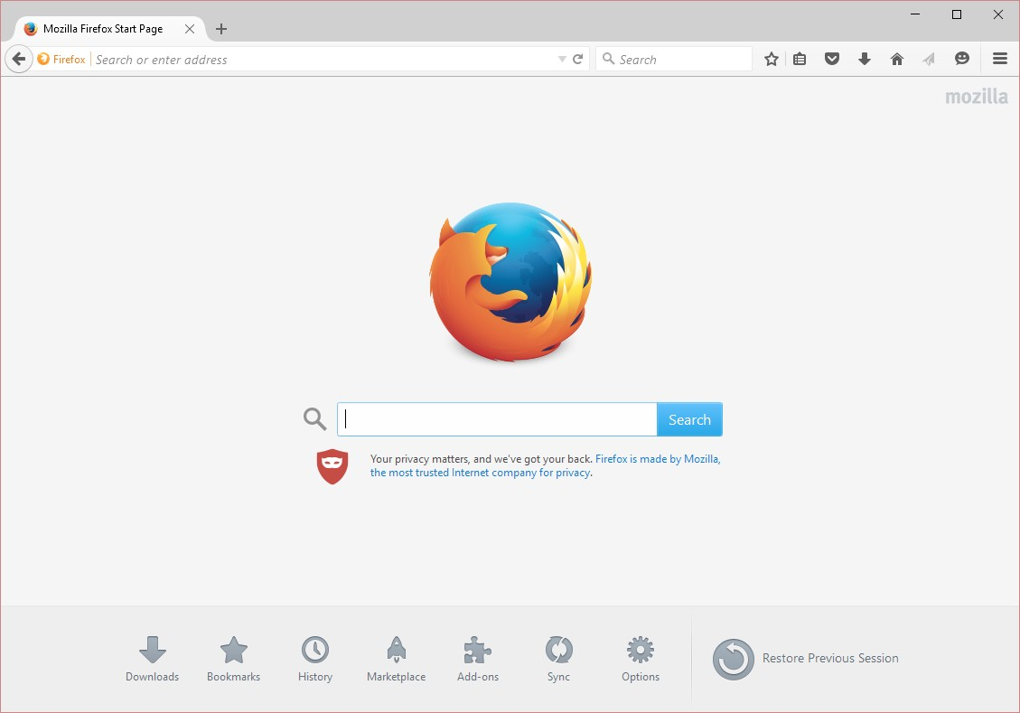

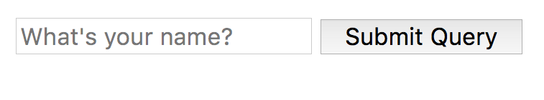



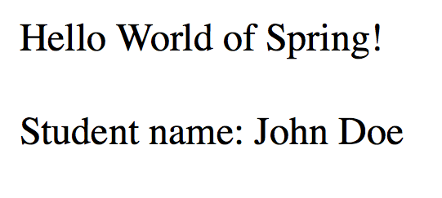

Application Flow
Request Mapping
helloworld-form.jsp
/showForm
HelloWorld Controller
Request Mapping
/processForm
helloworld.jsp
helloworld-form.jsp
HelloWorld Controller

Slide 27
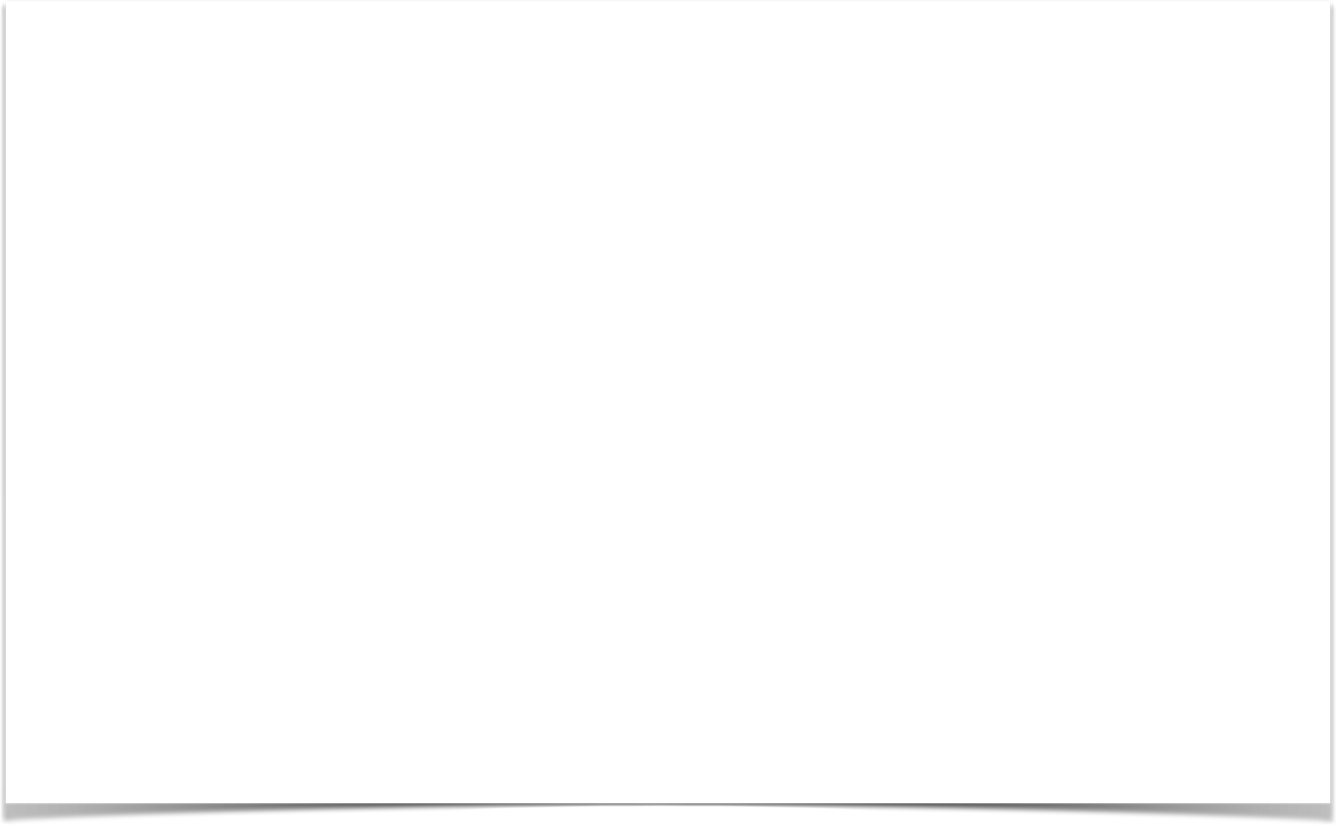
Controller Class
@Controller
public class HelloWorldController {
// need a controller method to show the initial HTML form @RequestMapping("/showForm")
public String showForm() { return "helloworld-form";
}
// need a controller method to process the HTML form @RequestMapping("/processForm")
public String processForm() { return "helloworld";
}
}

Slide 28
Development Process
Step-By-Step
Create Controller class
Show HTML form
Create controller method to show HTML Form
Create View Page for HTML form
Process HTML Form
Create controller method to process HTML Form
Develop View Page for Confirmation

Slide 29
Adding Data to Spring Model
Date

Slide 30
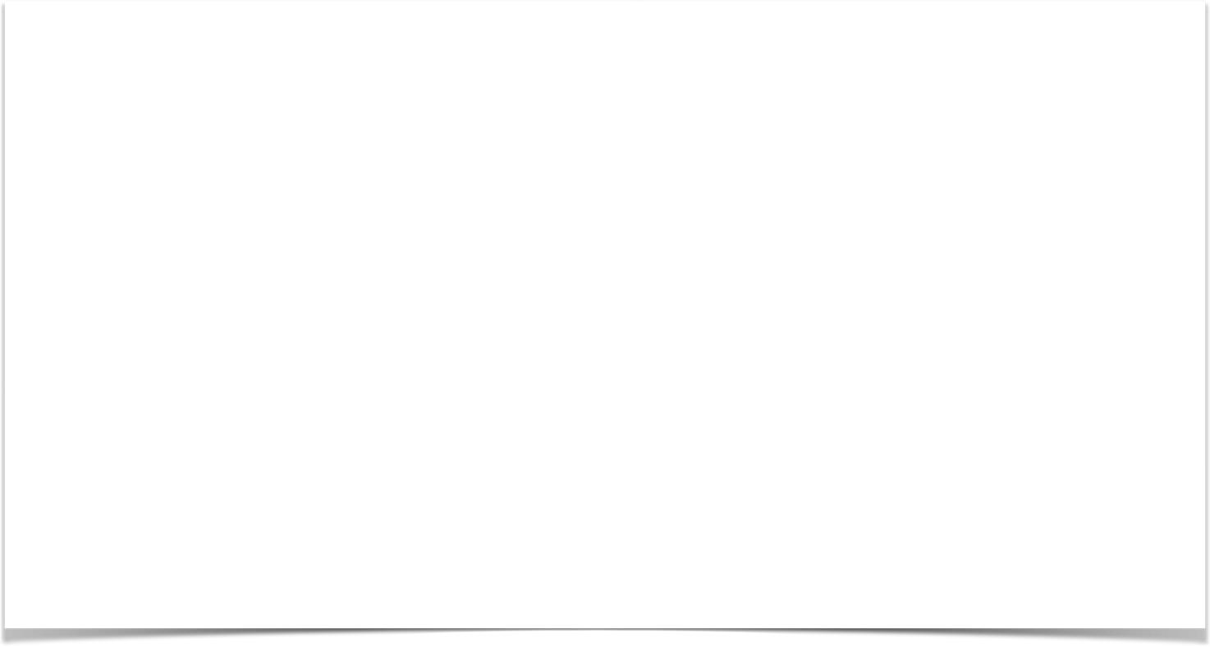
Passing Model to your Controller
@RequestMapping("/processFormVersionTwo")
public String letsShoutDude(HttpServletRequest request, Model model) {
// read the request parameter from the HTML form
String theName = request.getParameter("studentName");
// convert the data to all caps theName = theName.toUpperCase();
// create the message
String result = "Yo! " + theName;
// add message to the model model.addAttribute("message", result);
return "helloworld";
}

Slide 31
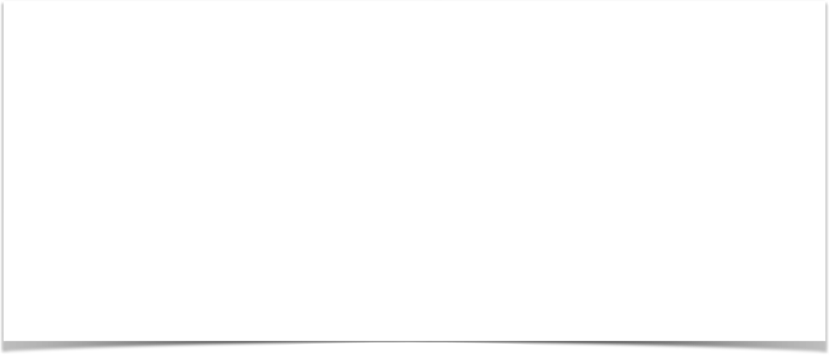
View Template - JSP
<html><body>
Hello World of Spring!
...
The message: ${message}
</body></html>

Slide 32
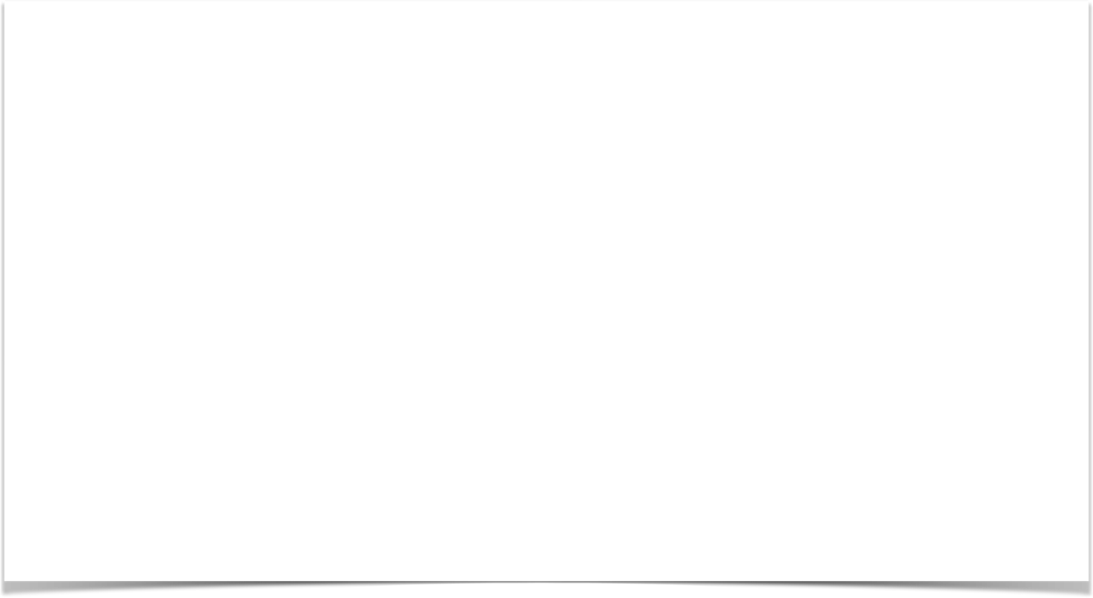
Adding more data to your Model
// get the data
//
String result = …
List<Student> theStudentList = … ShoppingCart theShoppingCart = …
// add data to the model
//
model.addAttribute("message", result);
model.addAttribute("students", theStudentList); model.addAttribute("shoppingCart", theShoppingCart);

Slide 33
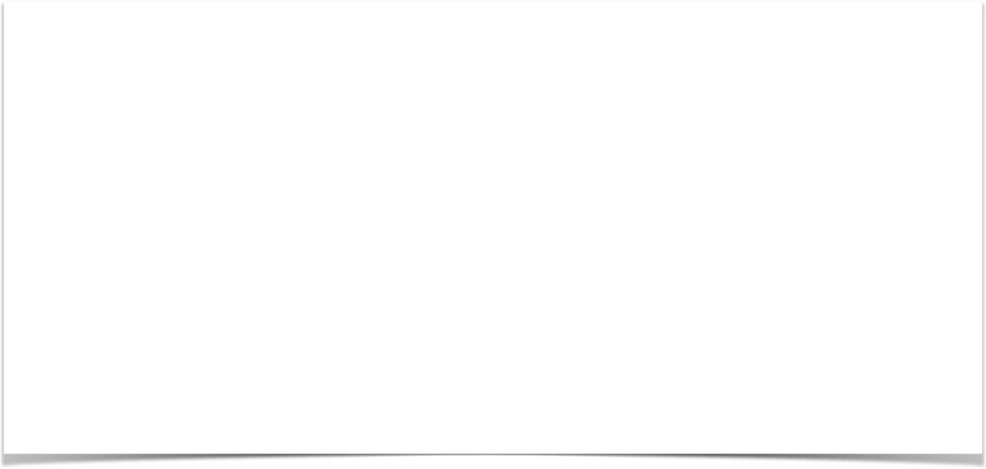


Controller Request Mapping
@RequestMapping("/funny") public class FunnyController {
@RequestMapping("/showForm") public String showForm() {
...
}
/funny/showForm
/funny/processForm
@RequestMapping("/processForm")
public String process(HttpServletRequest request, Model model) {
...
}
}

Slide 34
Spring MVC Form Tags

Slide 35
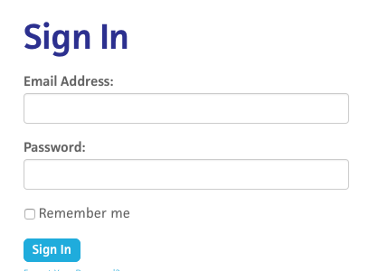
Review HTML Forms
•
HTML Forms are used to get input from the user

Slide 36
Spring MVC Form Tags
•
Spring MVC Form Tags are the building block for a web page
•
Form Tags are configurable and reusable for a web page

Slide 37
Data Binding
•
Spring MVC Form Tags can make use of data binding
•
Automatically setting / retrieving data from a Java object / bean

Slide 38













Spring MVC Form Tags
Form tags will generate HTML for you :-)
Form Tag Description
form:form | main form container
form:input | text field
form:textarea | multi-line text field
form:checkbox | check box
form:radiobutton | radio buttons
form:select | drop down list
more ….

Slide 39
Web Page Structure
•
JSP page with special Spring MVC Form tags
<html>
… regular html …
… Spring MVC form tags …
… more html …
</html>
www.luv2code.com

Slide 40

How To Reference Spring MVC Form Tags
Specify the Spring namespace at beginning of JSP file
<%@ taglib prefix="form" uri="http://www.springframework.org/tags/form" %>

Slide 41
Spring MVC Form Tag - Text Field

Slide 42


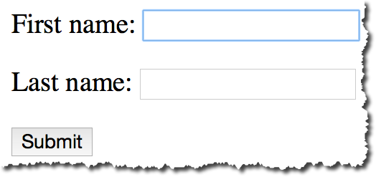


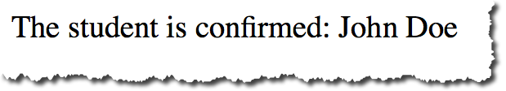
Big Picture
student-form.jsp
Student
Student Controller
Student
student-confirmation.jsp

Slide 43
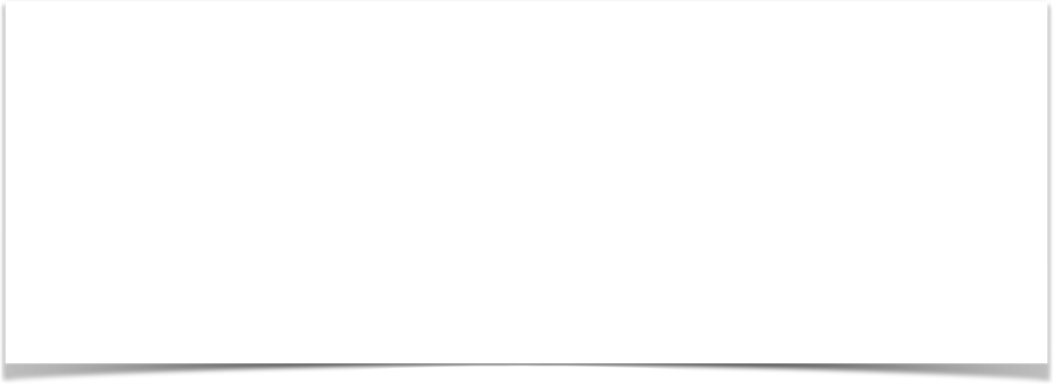
Show Form - Add Model Attribute
Code snippet from Controller
@RequestMapping("/showForm")
public String showForm(Model theModel) {
theModel.addAttribute("student", new Student()); return "student-form";
}

Slide 44
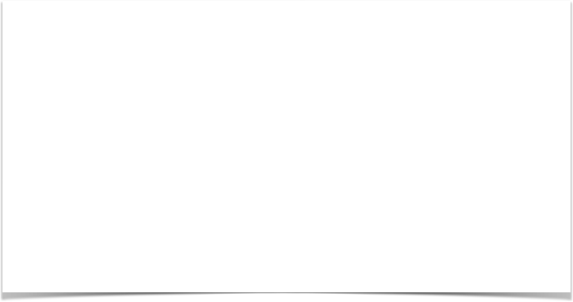

Setting up HTML Form - Data Binding
<form:form action="processForm" modelAttribute="student">
First name: <form:input path="firstName" />
<br><br>
Last name: <form:input path="lastName" />
<br><br>
<input type="submit" value="Submit" />
</form:form>

Slide 45


When Form is Loaded … fields are populated
<form:form action="processForm" modelAttribute="student">
First name: <form:input path="firstName" />
When form is loaded, Spring MVC will call:
<br><br>
Last name: <form:input path="lastName" />
student.getFirstName()
…
<br><br>
student.getLastName
<input type="submit" value="Submit" />
</form:form>

Slide 46

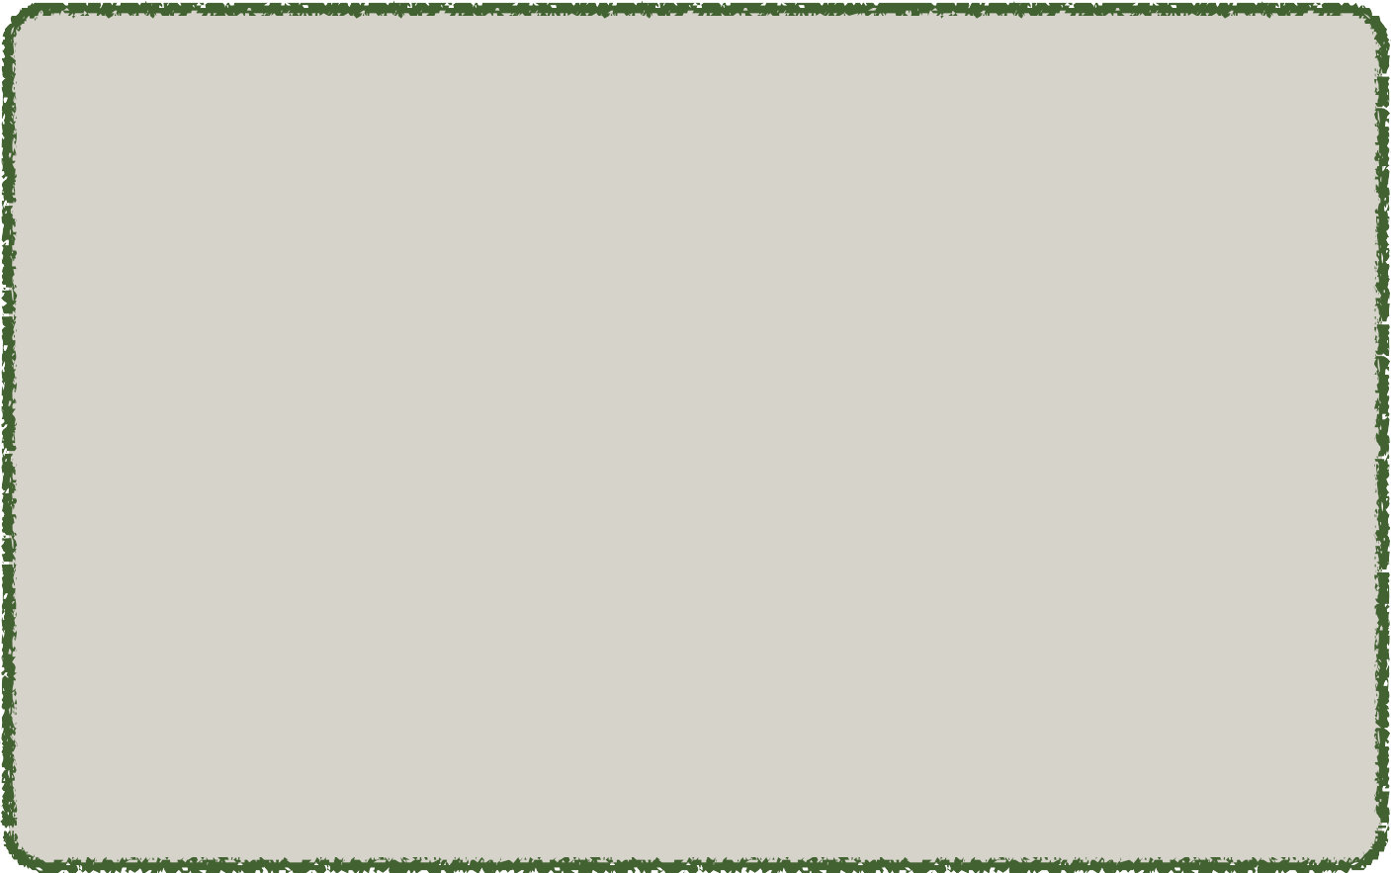
When Form is submitted … calls setter methods
<form:form action="processForm" modelAttribute="student">
First name: <form:input path="firstName" />
When form is submitted, Spring MVC will call:
<br><br>
Last name: <form:input path="lastName" />
student.setFirstName(…)
…
<br><br>
student.setLastName(…)
<input type="submit" value="Submit" />
</form:form>

Slide 47
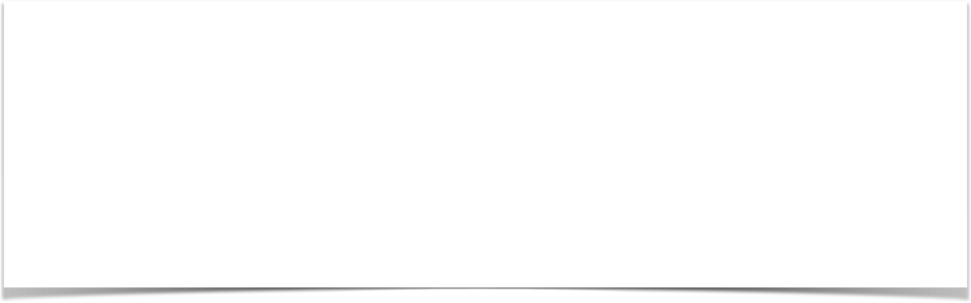
Handling Form Submission in the Controller
Code snippet from Controller
@RequestMapping("/processForm")
public String processForm(@ModelAttribute("student") Student theStudent) {
// log the input data
System.out.println("theStudent: " + theStudent.getFirstName()
+ " " + theStudent.getLastName());
return "student-confirmation";
}

Slide 48
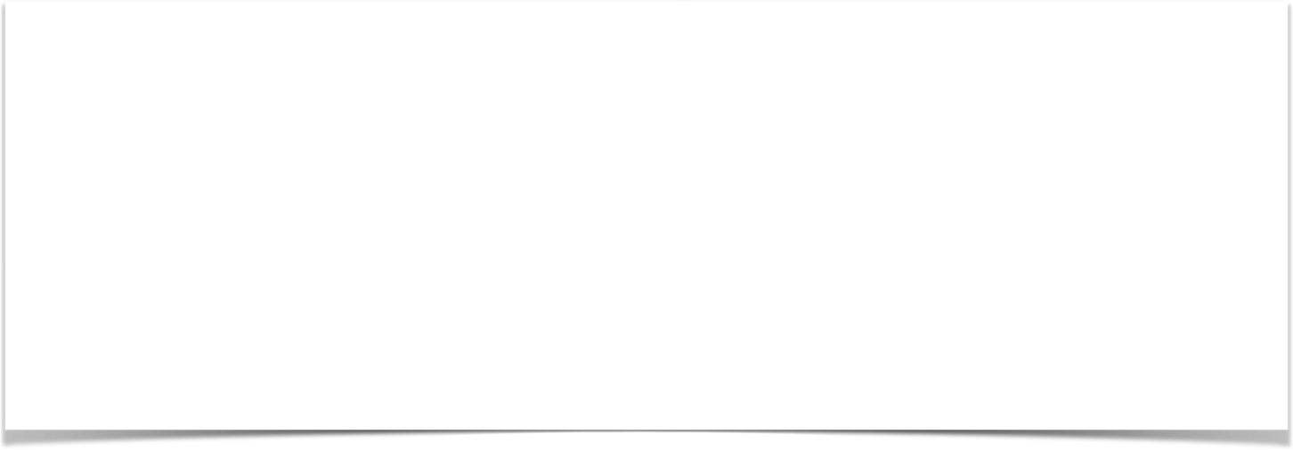

Confirmation page
<html>
<body>
The student is confirmed: ${student.firstName} ${student.lastName}
</body>
</html>

Slide 49
Development Process
Step-By-Step
Create Student class
Create Student controller class
Create HTML form
Create form processing code
Create confirmation page

Slide 50
Spring MVC Form Tag - Drop Down List

Slide 51
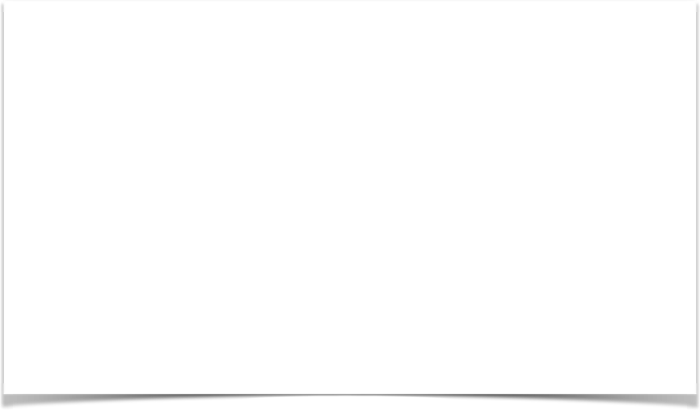

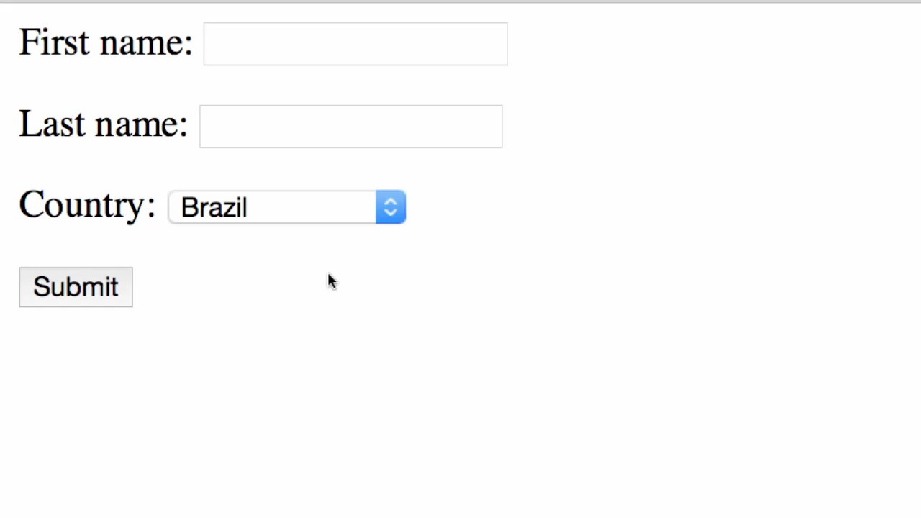
Review of HTML <select> Tag
<select name=“country”>
<option>Brazil</option>
<option>France</option>
<option>Germany</option>
<option>India</option>
...
</select>

Slide 52
Spring MVC Tag
Drop-Down List is represented by the tag
<form:select>

Slide 53

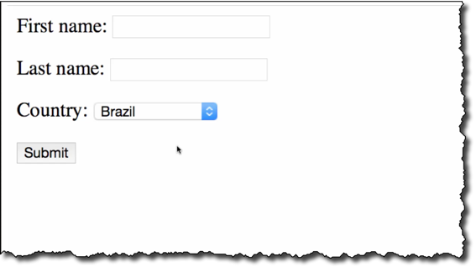
Code Snippet
<form:select path="country">
<form:option value="Brazil" label="Brazil" />
<form:option value="France" label="France" />
<form:option value="Germany" label="Germany" />
<form:option value="India" label="India" />
</form:select>

Slide 54
Spring MVC Form Tag - Radio Buttons

Slide 55
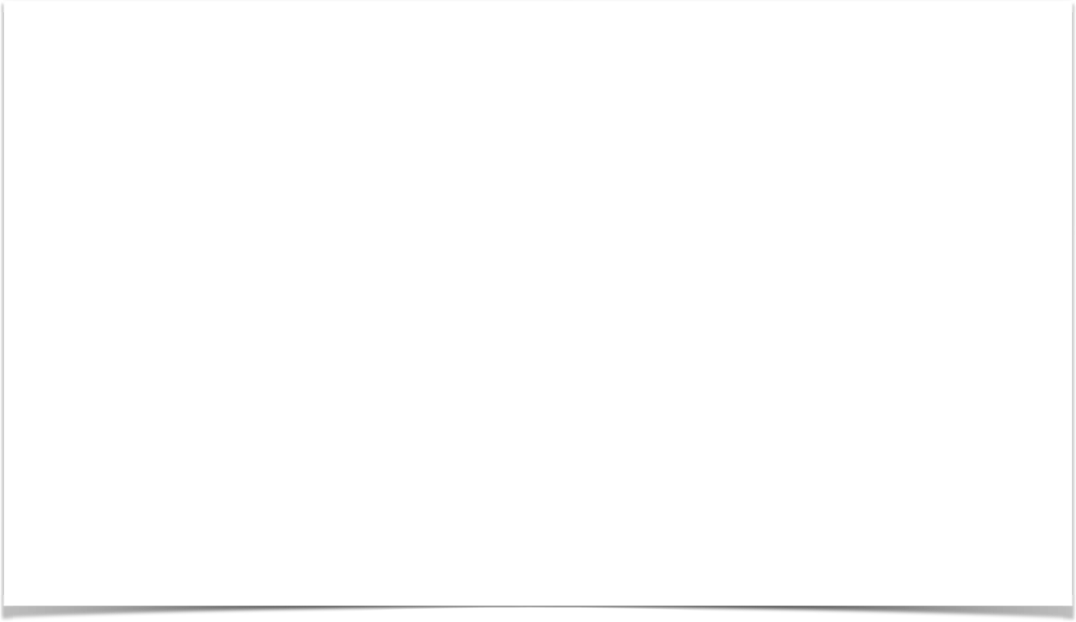
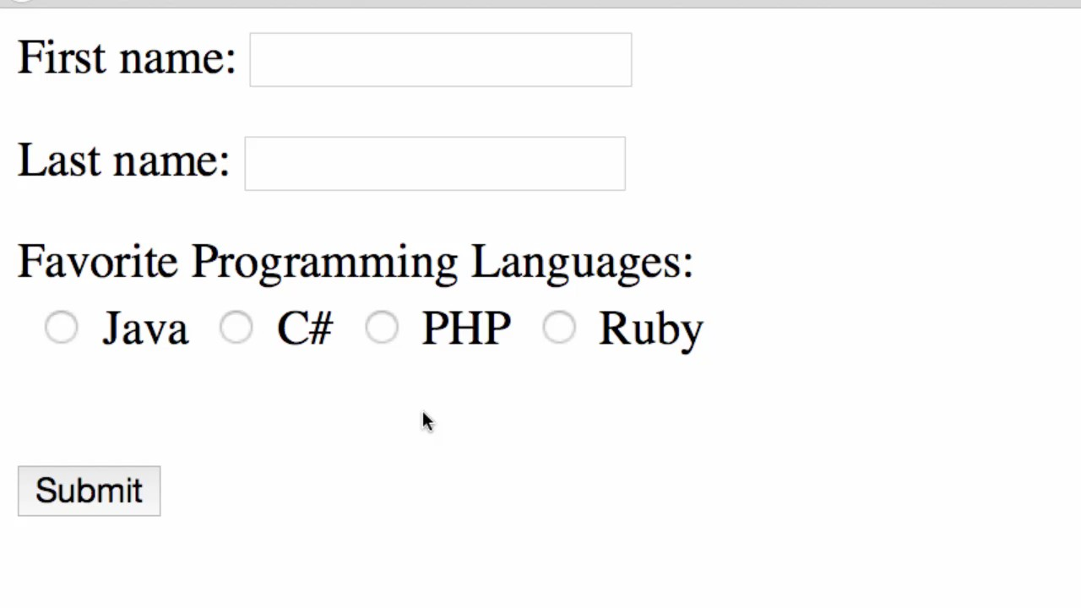
Radio Button Demo

Slide 56
Spring MVC Tag
A Radio Button is represented by the tag
<form:radiobutton>

Slide 57
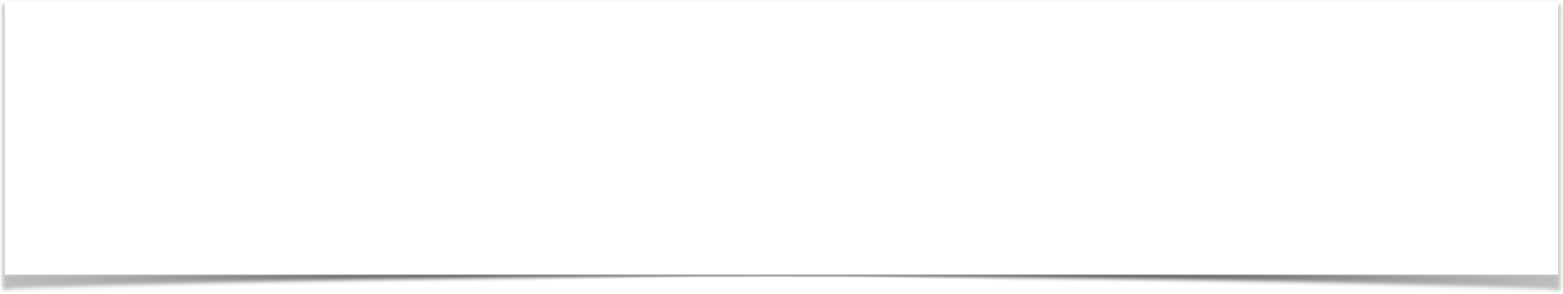
Code Example
Java <form:radiobutton path="favoriteLanguage" value="Java" /> C# <form:radiobutton path="favoriteLanguage" value="C#" /> PHP <form:radiobutton path="favoriteLanguage" value="PHP" />
Ruby <form:radiobutton path="favoriteLanguage" value="Ruby" />

Slide 58
Development Process
Step-By-Step
Update HTML form
Update Student class - add getter/setter for new property
Update confirmation page

Slide 59
Spring MVC Form Tag - Check Box

Slide 60
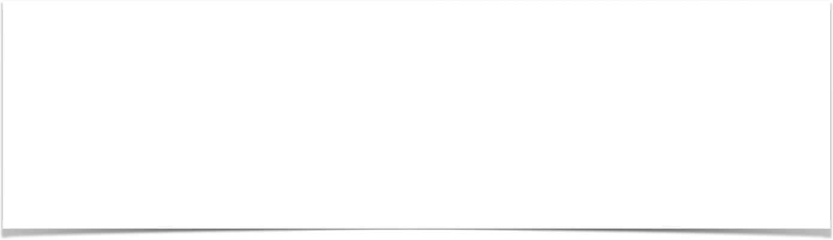
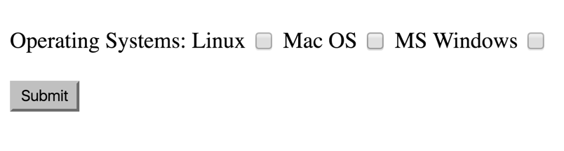
Check Box - Pick Your Favorite OS

Slide 61
Spring MVC Tag
A Check Box is represented by the tag
<form:checkbox>

Slide 62
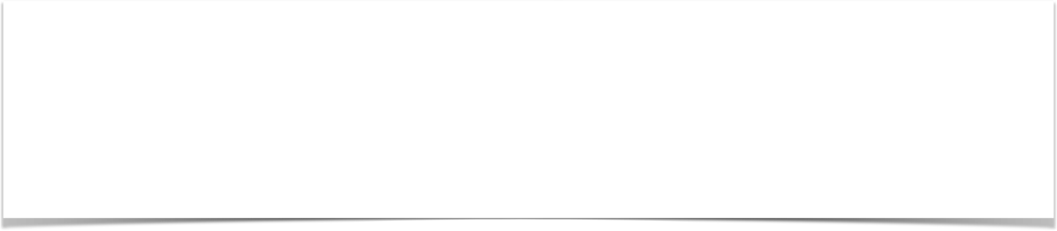
Code Example
Linux <form:checkbox path="operatingSystems" value="Linux" /> Mac OS <form:checkbox path="operatingSystems" value="Mac OS" /> MS Windows <form:checkbox path="operatingSystems"
value="MS Windows" />

Slide 63
Development Process
Step-By-Step
Update HTML form
Update Student class - add getter/setter for new property
Update confirmation page

Slide 64
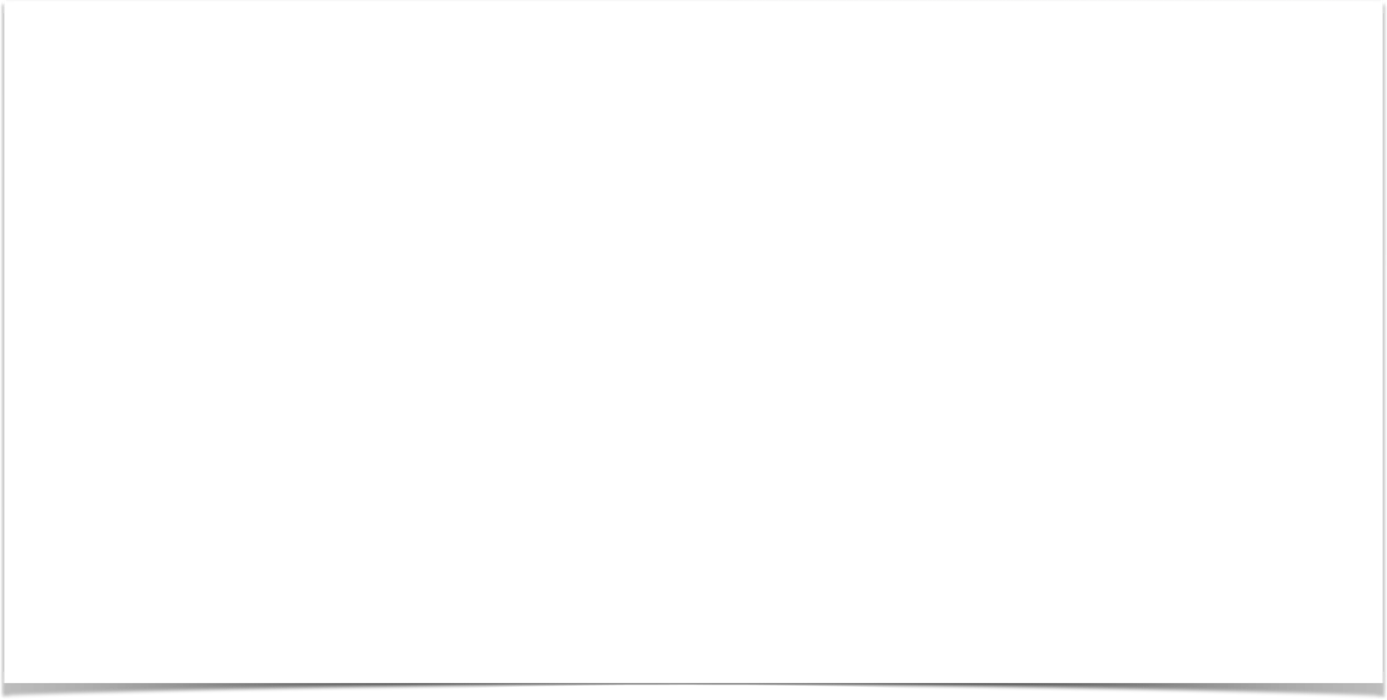

Spring MVC Form Validation

Slide 65
Java’s Standard Bean Validation API
•
Java has a standard Bean Validation API
•
Defines a metadata model and API for entity validation
•
Not tied to either the web tier or the persistence tier
•
Available for server-side apps and also client-side JavaFX/Swing apps
http://www.beanvalidation.org

Slide 66





Bean Validation Features
Validation Feature
required
validate length
validate numbers
validate with regular expressions
custom validation

Slide 67








Validation Annotations
Annotation Description
@NotNull | Checks that the annotated value is not null
@Min | Must be a number >= value
@Max | Must be a number <= value
@Size | Size must match the given size
@Pattern | Must match a regular expression pattern
@Future / @Past | Date must be in future or past of given date
others …

Slide 68
Our Road Map
set up our development environment
required field
validate number range: min, max
validate using regular expression (regexp)
custom validation

Slide 69
Spring MVC Form Validation Required Fields

Slide 70
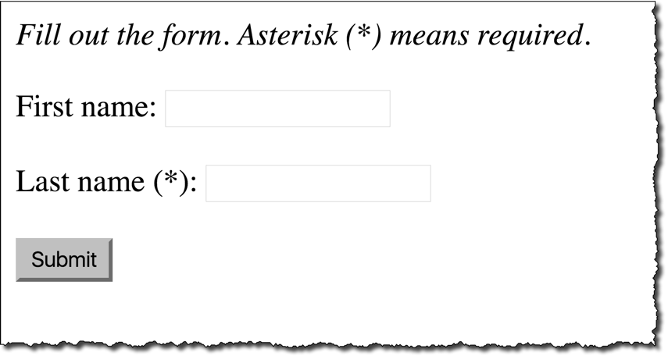
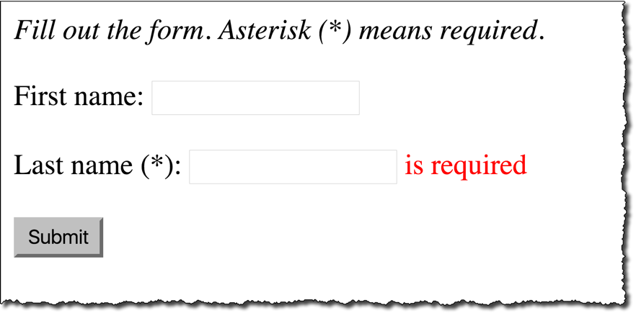

Required Fields

Slide 71

Pulling It All Together
customer-form.jsp
Customer
Customer Controller
Customer
customer-confirmation.jsp

Slide 72
Development Process
Step-By-Step
Add validation rule to Customer class
Display error messages on HTML form
Perform validation in the Controller class
Update confirmation page

Slide 73

Step 1: Add validation rule to Customer class
import javax.validation.constraints.NotNull; import javax.validation.constraints.Size;
public class Customer {
private String firstName;
@NotNull(message="is required") @Size(min=1, message="is required") private String lastName;
// getter/setter methods
}

Slide 74
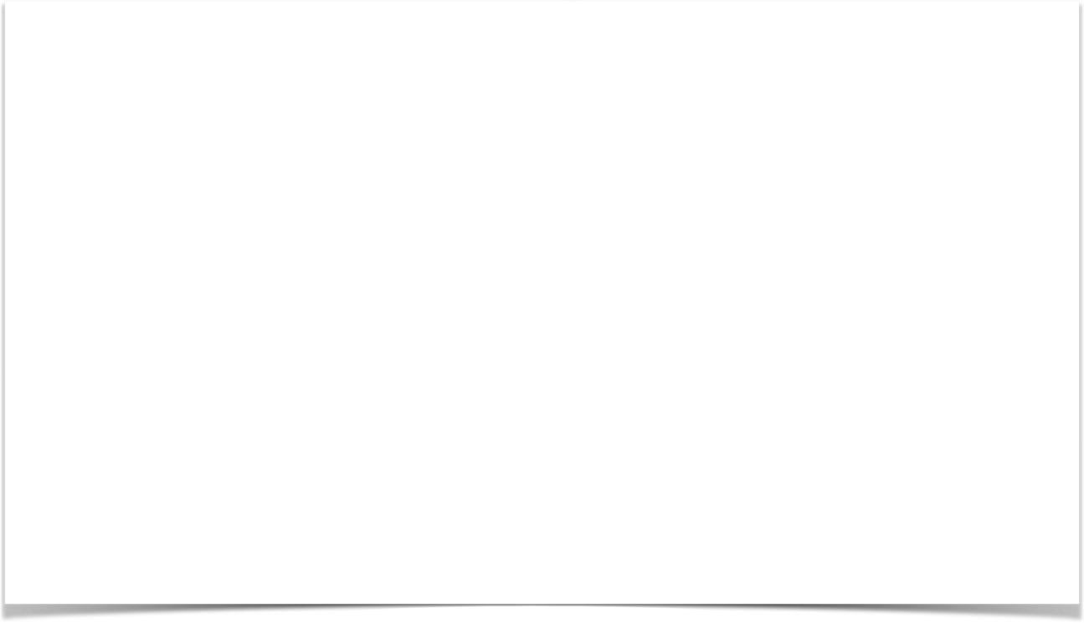
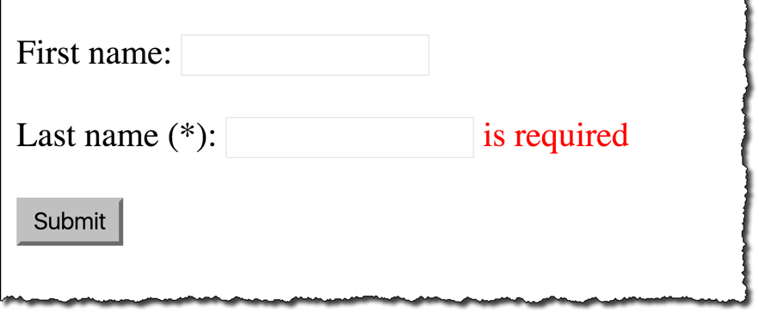
Step 2: Display error message on HTML form
customer-form.jsp
<form:form action="processForm" modelAttribute="customer"> First name: <form:input path="firstName" />
<br><br>
Last name (*): <form:input path="lastName" />
<form:errors path="lastName" cssClass="error" />
<br><br>
<input type="submit" value="Submit" />
</form:form>

Slide 75
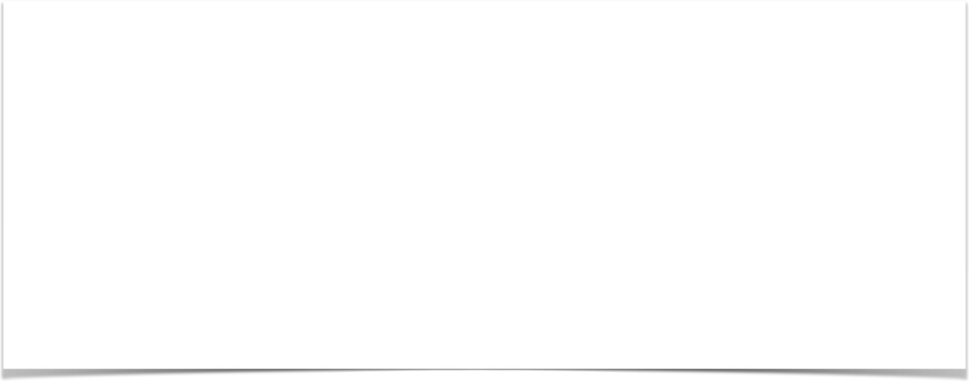
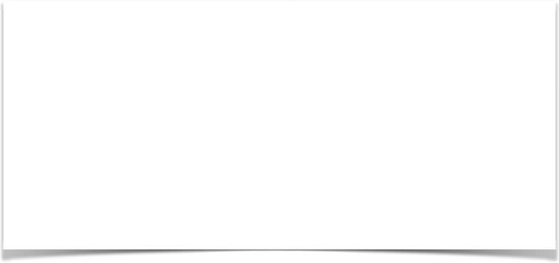
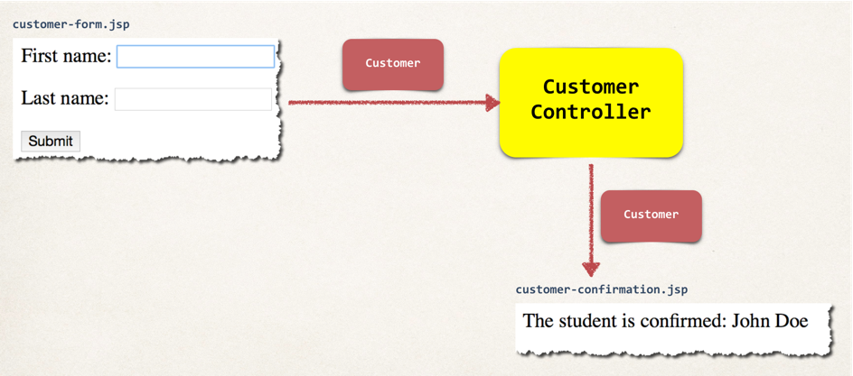
Step 3: Perform validation in Controller class
@RequestMapping("/processForm") public String processForm(
@Valid @ModelAttribute("customer") Customer theCustomer, BindingResult theBindingResult) {
if (theBindingResult.hasErrors()) { return "customer-form";
}
else {
return "customer-confirmation";
}
}

Slide 76
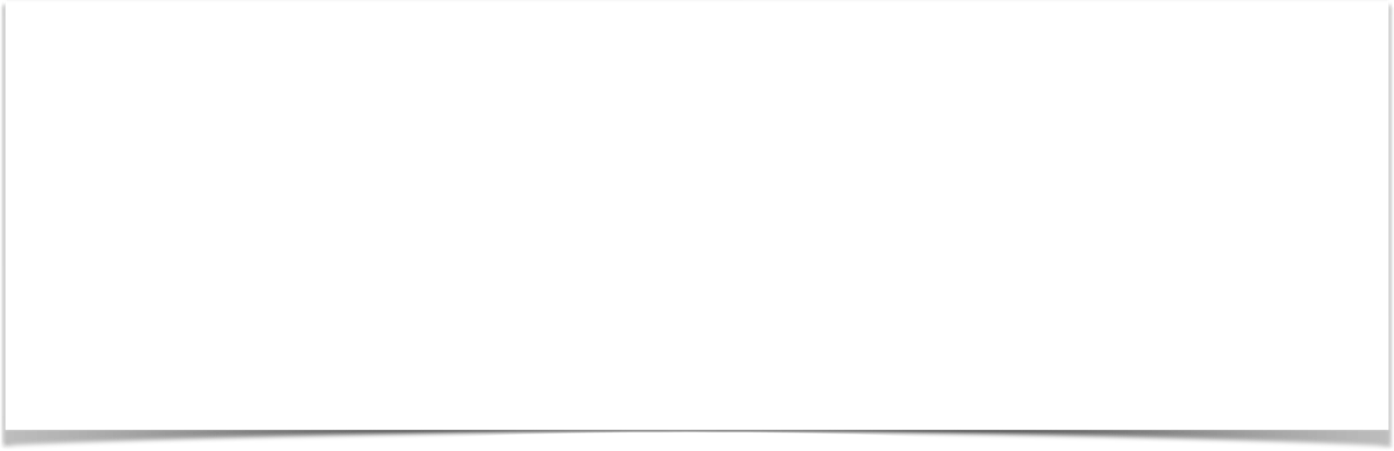
Step 4: Update confirmation page
<html>
<body>
The customer is confirmed: ${customer.firstName} ${customer.lastName}
</body>
</html>

